Slide 1
Unit 4

Slide 2
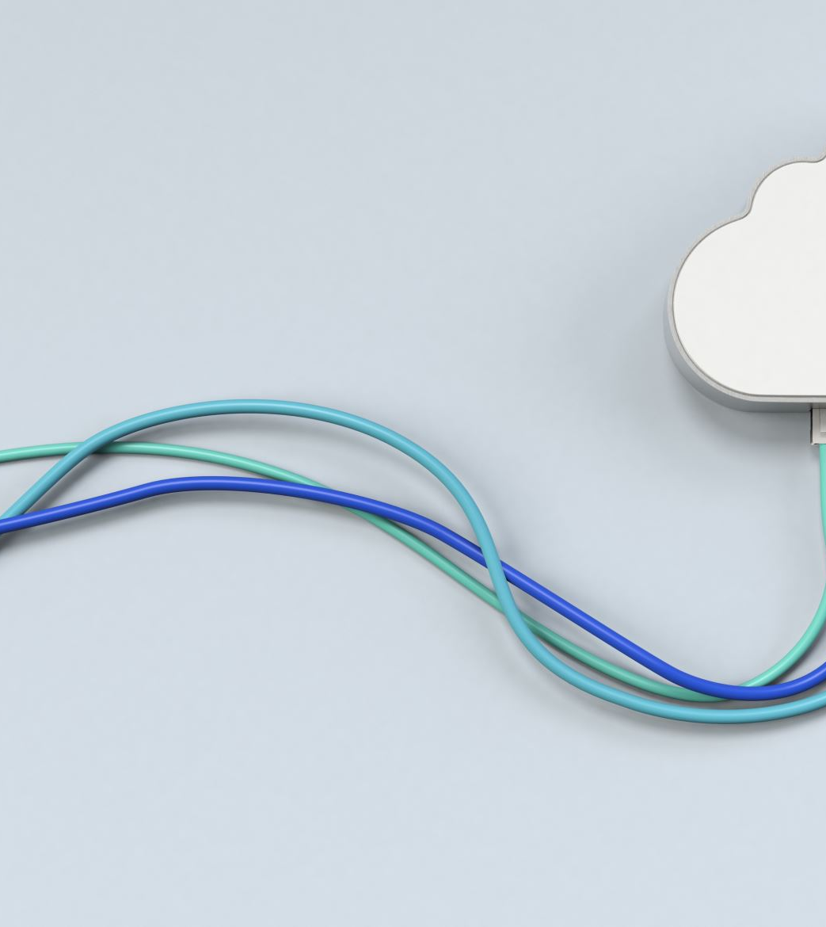
Computer Network
Computer networking refers to interconnecting computers and other digital devices to share resources (like files, printers, or internet), communicate, and exchange data.

Slide 3
[ISP] ⇄ [Modem] ⇄ [Router] ⇄ [Switch] ⇄ [PCs, Printers, Smart TVs]
Modem: Talks to your ISP and brings the internet in.
Router: Shares that internet with your home and manages IP addresses.
Switch: Lets your devices talk to each other efficiently in the local network.

Slide 4
Feature | Modem | Router | Switch
Main Function | Modulates/Demodulates signals between digital (computer) and analog (ISP) | Routes data between different networks (e.g., LAN to WAN) | Forwards data within a local network (LAN)
IP Address Handling | Usually has 1 public IP from ISP | Assigns private IPs to devices, uses NAT | Does not assign IPs, just uses MAC addresses
Packet Forwarding | Forwards data between ISP and router | Forwards packets based on IP addresses | Forwards frames based on MAC addresses
Connectivity | Connects to ISP and router | Connects to modem and switch or devices | Connects multiple devices (PCs, printers, etc.)
NAT & DHCP | ❌ Not built-in (modem only) | ✅ Yes | ❌ No
Example Use | Required to get internet from ISP | Used to share internet with devices | Used to expand a wired network in offices/homes

Slide 5
Device | What it Does | Think of it Like
Modem | Connects your home to the internet | A translator that speaks to your Internet Service Provider (ISP)
Router | Connects different networks (like your home network to the internet) and directs traffic | A traffic manager that tells data where to go
Switch | Connects devices within the same local network (like PC, printer, etc.) | A power strip for data – helps devices talk to each other

Slide 6
A switch is a device that connects multiple devices (like computers, printers, etc.) in a Local Area Network (LAN) and helps them communicate efficiently.

Slide 7
⚙️ How It Works (Step-by-Step):
Devices Connect: All devices plug into the switch using Ethernet cables.
Learns MAC Addresses: The switch remembers the unique hardware addresses (MAC) of each device and which port it's connected to.
Smart Forwarding: When one device sends data, the switch checks its memory and sends it only to the correct device, not everyone.
Fast & Secure: This reduces network traffic and improves speed and security.

Slide 8
A switch is like a smart office assistant who:
Learns where everyone sits (MAC addresses)
Sends each document only to the correct desk (port)
Never shouts the message to the whole office

Slide 9
🔧 What is a Router?
A router is a networking device that forwards data packets between computer networks. It acts as a gateway between two or more networks—most commonly between your local home network (LAN) and the internet (WAN).

Slide 10
Routing Packets:
Routers examine the destination IP address of each incoming data packet.
Based on its routing table, it determines the best path for the packet to reach its destination.
It then forwards the packet to the next network on the path.

Slide 11
Firewall/Security:
Routers often include built-in firewalls to block unwanted incoming traffic and filter outgoing traffic based on rules.
2. DHCP (Dynamic Host Configuration Protocol):
The router assigns IP addresses to devices in the network automatically so you don't have to configure them manually.
3. NAT (Network Address Translation):
Most home routers use NAT to allow multiple devices on a private network to share a single public
IP address.
It translates private IP addresses (e.g., 192.168.0.x) to the public IP when communicating with the internet.

Slide 12
🧱 Key Components of a Router:
WAN port: Connects to the modem or internet.
LAN ports: Connect to local devices via Ethernet.
Wireless module: Provides Wi-Fi access (in wireless routers).
Routing table: Holds routes to various networks.
Firmware: Software that runs the router’s functions.

Slide 13
A routing table is like a map or GPS for a router. It tells the router where to send data packets based on their destination IP addresses.

Slide 14
A routing table contains a list of routes to different network destinations. Each entry (or row) in the table usually has:
Field | What It Means
Destination | The IP address or network the packet is going to
Subnet Mask | Defines the range of IPs for that destination
Next Hop | The IP address of the next router to forward the packet to
Interface | Which network interface to use (like LAN or WAN)
Metric | Cost or distance for the route (lower is better)

Slide 15
Router
Function: Connects different networks, typically your LAN to the internet (WAN).
Layer: Operates at Layer 3 (Network Layer).
Extra Features: Can perform NAT (Network Address Translation) and DHCP.
📦 NAT: Allows multiple devices in your LAN to share a single public IP.

Slide 16
Router
🏠 Think of it like this:
A router is like a delivery person inside your home or office.
When you ask for something on the internet (like opening Google), 👉 the router takes your request and sends it out to the internet.
When the internet sends the answer back (like Google’s page), 👉 the router brings it back to your device — not someone else’s.

Slide 17
💡 Imagine your Wi-Fi router as a traffic cop for the internet.
Your internet connection is like a big road bringing information to your house.
Inside your house, you have multiple devices – phones, laptops, smart TVs – all wanting to use that road.
The router makes sure the internet traffic gets to the right device – like a traffic cop telling the cars (data) where to go.

Slide 18
It connects your devices (phone, laptop, etc.) to the internet.
It also helps your devices talk to each other (like sending files from your laptop to your printer).
It usually connects to a modem, which is what brings the internet from your provider (like Jio, Airtel, etc.) into your home.

Slide 19
💡 What It Does:
Connects you to the internet It brings the internet to your home/office from the outside world.
Shares internet with all devices It lets all your devices — phones, computers, TVs — use that internet at the same time.
Knows who asked for what It keeps track of which device asked for which website or video, and makes sure the right data goes to the right place.

Slide 20
What a Modem Does (Step-by-Step):
🔌 1. Connects to the ISP Line
The modem connects to your phone line, fiber line, or cable — this is how internet enters your building.
🧪 2. Converts Signals
It takes the signal coming from the ISP (light signals in fiber, or electrical pulses in phone/cable lines),
And converts it into data that your router and devices can understand.
📤 3. Sends Data to the Router
The modem passes the internet data to the router,
The router then shares it with all your devices (via Wi-Fi or LAN).

Slide 21
Example:
Let’s say you’re watching Netflix:
You press play on your phone.
Your router sends the request to the modem.
The modem talks to the ISP and brings back the movie.
It gives the movie data to the router.
The router sends it to your phone.

Slide 22
📌 Important Note:
A modem connects you to the internet.
A router shares the internet with all your devices.
Sometimes, both are combined in one box — that’s called a modem-router combo.

Slide 23
A. LAN (Local Area Network)
Definition: A network that connects devices within a small area, such as a single office, home, or building.
Technical Aspects:
Uses Ethernet cables (Cat5e, Cat6) or Wi-Fi for connection.
Devices use private IP addresses (like 192.168.0.1) and communicate through a switch or router.
Example: In a software development company, all developers’ computers are connected through a LAN to share files and use the same printer and internet.

Slide 24
🧠 Real-World Example:
TechNest Inc. (our imaginary IT company) has a single office building in Bengaluru.
Inside the building:
30 employees use computers
There are 3 printers, 1 server, and a Wi-Fi router
All these devices are connected to share files, access the internet, and print
🎯 This is a LAN.

Slide 25
⚙️ How It’s Established:
Devices: Computers, printers, routers, switches
Networking Devices:
Switch to connect all devices via Ethernet cables
Wi-Fi Router to connect wireless devices
IP Addresses are given to each device to communicate
LAN Configuration:
Admin sets up file sharing, printer access, and permissions
Employees use this network to access internal resources quickly
📡 Optional: Wi-Fi Access Point for wireless devices 🔌 Wired LAN = Faster & more secure 📶 Wireless LAN = More flexible but slightly slower

Slide 26
MAN (Metropolitan Area Network)
B. Definition: A network that covers a city-sized area or a large campus (e.g., universities, tech parks).
Technical Aspects:
Uses fiber-optic cables or microwave radio links.
Often managed by a telecom provider or a private IT team.
Supports high-speed data transfer across large buildings.
Example: A company's branches in different parts of a city are connected via MAN, enabling smooth file transfer and VoIP calls between locations.

Slide 27
🧠 Real-World Example:
TechNest Inc. has 3 branch offices:
Office A in Koramangala
Office B in Whitefield
Office C in HSR Layout
They want all offices to share data, software, and internet securely.
🎯 They connect these 3 office LANs using MAN.

Slide 28
How It’s Established:
Fiber Optic/Leased Lines: TechNest leases fiber optic cables from a telecom provider like Airtel or ACT to connect the offices.
Routers and Switches: Each office uses routers and switches to route data across branches.
Private IP Ranges: Devices in all offices use internal IP addresses to form a larger network.
VPNs (Virtual Private Networks): Sometimes used to securely encrypt communication between offices.
Firewall protects each office from public internet threats.
🔁 Now they can:
Share files between teams in different locations
Use one central payroll and HR system
Manage employees and systems remotely

Slide 29
C. WAN (Wide Area Network)
Definition: A network that spans large geographic areas like countries or continents.
Technical Aspects:
Uses leased telephone lines, satellites, or submarine fiber cables.
The Internet is the largest WAN.
Needs modems, routers, and firewalls to manage traffic and security.
Example: An IT company has offices in Bangalore, San Francisco, and Berlin—all connected over a WAN using secure VPNs and the internet.

Slide 30
Real-World Example:
TechNest Inc. now has branches in:
Bengaluru 🇮🇳
San Francisco 🇺🇸
London 🇬🇧
They want:
One common HR system
Company-wide Zoom calls
Global server access
🎯 They set up a WAN to connect all global branches.

Slide 31
How It’s Established:
ISP Connections: Each office connects to the internet via a local Internet Service Provider.
VPN or MPLS (Multi-Protocol Label Switching):
TechNest sets up VPN tunnels between countries to encrypt and secure traffic.
OR, they may pay for a private WAN circuit (like MPLS) through global telecom providers like Tata Communications or AT&T.
Firewalls & Proxy Servers are added to protect and manage internet traffic.
Cloud Integration: They may use services like AWS or Google Cloud to sync global data centers.
📦 Result:
Teams across countries can collaborate like they’re in the same building.
Shared tools, file servers, databases are available worldwide.

Slide 32
Network Type | Area Covered | Example | Setup Components
LAN | Single building or floor | Office, school, home | Switch, router, Ethernet cables, Wi-Fi
MAN | City-wide area | Company branches in one city | Fiber lines, routers, leased lines, VPN
WAN | Across cities/countries | Global offices or banks | Internet, VPN, MPLS, firewalls, cloud

Slide 33
1. End Devices (Clients) – The users
These are the devices that people use to interact with the network.
Examples:
🖥️ Desktops and Laptops
📱 Smartphones and Tablets
🖨️ Printers, Scanners
🧠 Servers (central storage or apps)
🎯 These are called clients or nodes.
Without them, there’s no point in having a network—these devices are the reason the network exists.

Slide 34
🔌 2. Network Interface Card (NIC) – The connector
Every device that connects to a network needs a NIC (Network Interface Card). It can be:
🧲 Wired NIC – with an Ethernet port
📡 Wireless NIC – with Wi-Fi capability
📦 It gives the device a MAC address (a unique hardware ID) so it can talk to other devices.

Slide 35
🛑 6. Firewall – The security gate
📌 What it does:
Controls what data can enter or leave your network
Protects from hackers, viruses, suspicious traffic
📦 Analogy: Like a security guard at the main gate, checking every visitor.
Setup:
Built into routers (basic level)
Can also be a separate hardware box (for bigger businesses)
Admin sets rules like: block ports, allow only approved IPs, etc.

Slide 36
⚙️ How a Firewall Works (Step-by-Step)
🧩 Step 1: All Data is in Packets
When you use the internet, all information is sent in tiny packets — like digital envelopes.
Each packet has:
Source info (where it's from)
Destination info (where it's going)
Content (what it's carrying)

Slide 37
🚦 Step 2: Packet Reaches the Firewall
Before entering your system, each packet must go through the firewall.

Slide 38
📋 Step 3: Firewall Checks the Rules
The firewall checks:
Is the packet coming from a trusted source?
Is it going to an allowed port?
Does it match any known attack patterns?
It uses a set of rules like:
"Block everything from IP 123.456.789.0"
"Allow only web traffic on port 80/443"
"Block file downloads from unknown sites"

Slide 39
✅ Step 4A: If It's Safe — Allow
If the packet looks safe, it goes through. The data reaches your computer.

Slide 40
❌ Step 4B: If It’s Suspicious — Block
If the packet is dangerous or breaks a rule, the firewall stops it right there.
The bad data never enters your system.

Slide 41
🔄 Step 5: Same Happens for Outgoing Data
Firewalls also check outgoing data to prevent:
Sensitive information from leaking
Malicious software from connecting to hackers

Slide 42
🔍 Types of Firewalls (Briefly)
Hardware Firewall
A separate physical device.
Protects entire network.
Example: A firewall in your Wi-Fi router.
Software Firewall
Installed on individual devices.
Controls traffic for that device only.
Example: Windows Defender Firewall.
Cloud-Based / Next-Gen Firewall
Advanced firewalls with AI, behavior detection, etc.
Often used by companies for high-level protection.

Slide 43
Proxy Server – The smart assistant
📌 What it does:
Intermediary between users and the internet
Can block websites, cache content, or anonymize users
📦 Analogy: A PA (Personal Assistant) who fetches things for you and filters content.
Setup:
Installed on a separate server in the office
Devices are configured to connect through the proxy
Admin controls website access, logging, and caching

Slide 44
⚙️ How a Proxy Server Works (Step-by-Step)
🧍 Step 1: You Request Something You open your browser and ask for a website — like www.youtube.com.
🛰️ Step 2: Request Goes to the Proxy Instead of going straight to YouTube, the request first goes to the proxy server.
🌍 Step 3: Proxy Forwards the Request The proxy then sends the request to YouTube on your behalf.

Slide 45
Now YouTube thinks the request is coming from the proxy, not from you directly.
📦 Step 4: Proxy Gets the Response YouTube sends the webpage or video back to the proxy server.
📥 Step 5: Proxy Sends it Back to You The proxy finally sends the result to your device.

Slide 46
VPN (Virtual Private Network) – The secure tunnel
📌 What it does:
Encrypts data between two networks or a user and the company
Allows remote workers or branch offices to securely connect to HQ
📦 Analogy: Like a secret tunnel under the internet that no one can spy on.
Setup:
VPN software or hardware gateway
Used between cities, countries, or remote employees

Slide 47
Server – The central brain
📌 What it does:
Stores files, apps, websites, and more
Other devices (clients) request data from it
📦 Analogy: Like a library—you go there to get files or info.
Types of servers:
File server (for documents)
Web server (for websites)
Database server (for apps)
Setup:
Configured with an OS (like Windows Server or Linux)
Connected via switch and given a static IP

Slide 48
Security in Networking
Encryption: Scrambles data so that only the intended receiver can read it.
VPN (Virtual Private Network): Creates a secure tunnel for data over the internet.
Authentication: Verifies user identity (via username/password, biometrics, OTP).

Slide 49
How Does a Firewall Work (Technically)?
A firewall sits between the internal network (LAN) and the outside network (like the Internet). It analyzes every packet of data that tries to enter or leave and makes decisions based on rules.
🔍 Packet Inspection: It checks:
Source and destination IP address
Port number (which app is using the data)
Protocol (HTTP, FTP, etc.)
🚫 Rules and Policies: Admins set rules like:
Allow HTTP (port 80), block FTP (port 21)
Allow only internal IPs to access the server
Block all unknown incoming connections

Slide 50
🧱 Types of Firewalls
Type | Description | Layer
Packet Filtering Firewall | Basic firewall that checks each packet’s header info | Layer 3 (Network)
Stateful Inspection Firewall | Tracks connection states (beginning, ongoing, end) | Layer 4 (Transport)
Application Layer Firewall (Proxy Firewall) | Understands specific protocols like HTTP, FTP | Layer 7 (Application)
Next-Gen Firewall (NGFW) | Includes deep packet inspection, IDS/IPS, app awareness | Multi-layer

Slide 51
Example in an IT Company
Block all access to social media sites during work hours.
Allow only developers’ IPs to access GitHub.
Block port 3389 (Remote Desktop Protocol) from outside to prevent remote attacks.

Slide 52
🛠️ Hardware vs Software Firewall
Hardware firewall: A physical device (e.g., Cisco ASA, FortiGate) at the network perimeter.
Software firewall: Installed on individual machines (e.g., Windows Defender Firewall).

Slide 53
✅ What is a Proxy Server?
A proxy server is a system or application that acts as an intermediary between a client (your computer) and a destination server (like a website).
📦 Purpose: To control, monitor, filter, and anonymize internet access.
🧠 Simple Analogy: Imagine you're talking to someone through a translator. You say something → the translator (proxy) forwards it → and brings the response back. The final person doesn’t know who you are—only the proxy does.

Slide 54
🧰 Functions of a Proxy Server
✅ Access Control:
Block specific websites or services.
Allow browsing only during work hours.
🧼 Content Filtering:
Block inappropriate content.
Prevent users from accessing malicious websites.
🕵️ Anonymity and Privacy:
Hides user’s real IP address.
External websites see the proxy server’s IP.

Slide 55
🚀 Caching:
Stores copies of frequently visited sites.
Speeds up access and saves bandwidth.
📊 Monitoring and Logging:
Logs all user web activity.
Useful for audits, security, and HR compliance.

Slide 56
🔁 How Proxy Servers Work (Technically)
User sends a web request to the proxy server.
Proxy server evaluates the request.
If allowed, it sends the request to the destination server.
The server sends data back to the proxy.
Proxy forwards the data to the user.

Slide 57
📦 Types of Proxies
Type | Description
Forward Proxy | Sits between internal network and internet; controls what users access
Reverse Proxy | Sits in front of web servers; protects and manages incoming requests
Transparent Proxy | User doesn’t know it's there; no configuration needed
Anonymous Proxy | Hides user’s IP but reveals it’s using a proxy
High Anonymity Proxy | Hides both user identity and the fact it's a proxy
Caching Proxy | Saves copies of visited websites to reduce load and improve speed

Slide 58
🧠 Example in an IT Company
Employees access websites through a forward proxy.
The proxy blocks YouTube, Facebook, and personal email domains.
All traffic is logged and cached.
The company's public website is protected by a reverse proxy (like NGINX or Cloudflare) to filter traffic and handle load balancing.

Slide 59
🛡️ Firewall vs Proxy Server – What’s the Difference?
Feature | Firewall | Proxy Server
Purpose | Protects network from external threats | Controls and filters internet usage
Layer | Network/Transport Layer | Application Layer
Security | Blocks/Allows traffic based on rules | Hides internal network, filters content
Visibility | Sees data packets | Sees actual user requests (URLs, data)
Use Case | Prevent unauthorized access | Monitor and control user behavior

Slide 60
✅ Final Takeaway
A firewall is like a security guard checking if data is safe before it enters or leaves.
A proxy server is like a gatekeeper or translator that controls what users access and keeps their identity hidden.
Both can co-exist and are crucial in enterprise IT setups for security, performance, and policy enforcement.

Slide 61
IP Addressing
🔹 IP Address (Internet Protocol Address)
An IP address is a unique number assigned to each device on a network, so data knows where to go.
IPv4 – 32-bit, e.g., 192.168.1.10 (most common, but limited)
IPv6 – 128-bit, e.g., 2001:0db8:85a3:0000:0000:8a2e:0370:7334 (newer, for more devices)

Slide 62
IoT (Internet of Things)
IoT is a system where smart devices are connected to the internet to collect data and communicate.
Uses sensors, actuators, and controllers.
Communicates over Wi-Fi, Zigbee, LoRaWAN, etc.
🧠 Technical Example in IT Company:
Smart meeting room sensors detect availability.
Access control via biometric devices connected to LAN.
CCTV cameras stream footage to cloud servers.

Slide 63
Cloud Computing
Cloud Computing means storing and accessing the data and programs on remote servers that are hosted on the internet instead of the computer’s hard drive or local server.
Cloud computing is also referred to as Internet-based computing, it is a technology where the resource is provided as a service through the Internet to the user.
The data that is stored can be files, images, documents, or any other storable document.

Slide 64
Cloud computing helps users in easily accessing computing resources like storage, and processing over internet rather than local hardwares. Here we discussing how it works in nutshell:
Infrastructure: Cloud computing depends on remote network servers hosted on internet for store, manage, and process the data.
On-Demand Acess: Users can access cloud services and resources based on-demand they can scale up or down the without having to invest for physical hardware.
Types of Services: Cloud computing offers various benefits such as cost saving, scalability, reliability and acessibility it reduces capital expenditures, improves efficiency.

Slide 65
Origins Of Cloud Computing
Mainframe computing in the 1950s and the internet explosion in the 1990s came together to give rise to cloud computing. Since businesses like Amazon, Google, and Salesforce started providing web-based services in the early 2000s.

Slide 66
Front end ( Fat client, Thin client)
Back-end platforms ( Servers, Storage )
Cloud-based delivery and a network ( Internet, Intranet, Intercloud )

Slide 67
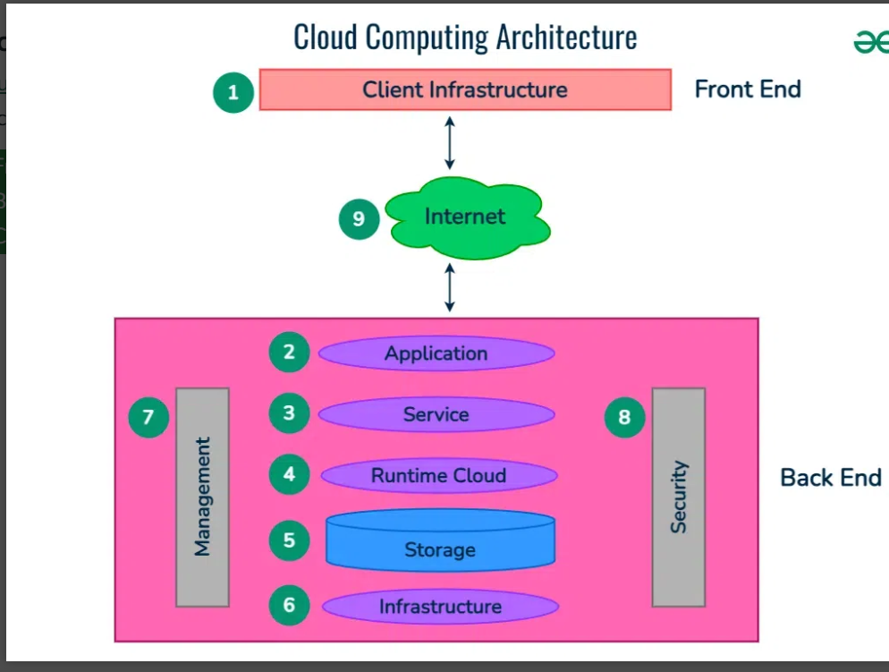

Slide 68
Front End ( User Interaction Enhancement )
The User Interface of Cloud Computing consists of 2 sections of clients. The Thin clients are the ones that use web browsers facilitating portable and lightweight accessibilities and others are known as Fat Clients that use many functionalities for offering a strong user experience.

Slide 69
Back-end Platforms ( Cloud Computing Engine )
The core of cloud computing is made at back-end platforms with several servers for storage and processing computing. Management of Applications logic is managed through servers and effective data handling is provided by storage. The combination of these platforms at the backend offers the processing power, and capacity to manage and store data behind the cloud.

Slide 70
Cloud-Based Delivery and Network
3. On-demand access to the computer and resources is provided over the Internet, Intranet, and Intercloud. The Internet comes with global accessibility, the Intranet helps in internal communications of the services within the organization and the Intercloud enables interoperability across various cloud services. This dynamic network connectivity ensures an essential component of cloud computing architecture on guaranteeing easy access and data transfer.

Slide 71
What Are The Types of Cloud Computing Services?
The following are the types of Cloud Computing:
Infrastructure as a Service (IaaS)
Platform as a Service (PaaS)
Software as a Service (SaaS)
Function as as Service (FaaS)

Slide 72
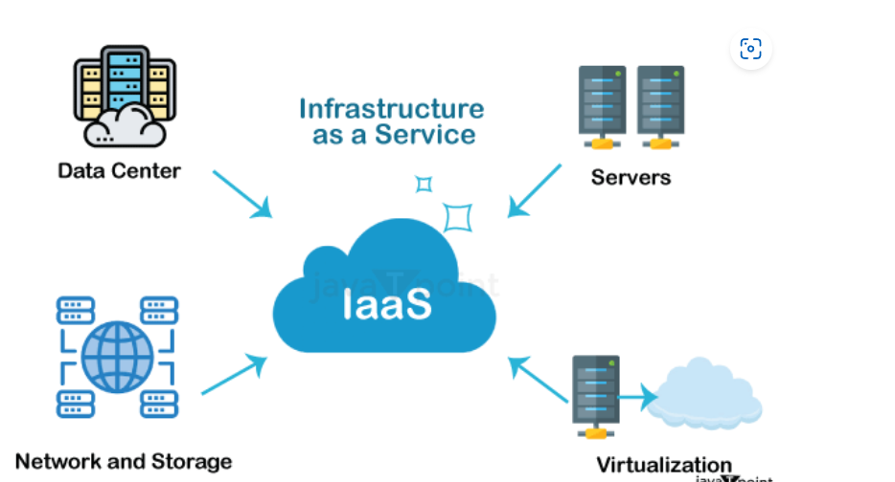

Slide 73
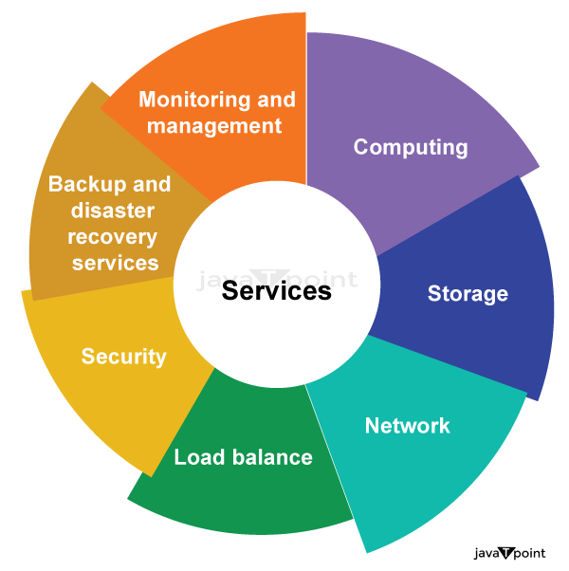

Slide 74
Example of IAAS (Infrastructure As A Service)
Amazon Web Services
Microsoft Azure
Google Compute Engine
Digital Ocean

Slide 75
Features of IAAS
Scalability: IaaS enables users to adjust computing capacity according to their demands without requiring long lead times or up-front hardware purchases.
Virtualization: IaaS uses virtualization technology to generate virtualized instances that can be managed and delivered on-demand by abstracting physical computer resources.
Resource Pooling: This feature enables users to share computer resources, such as networking and storage, among a number of users, maximizing resource utilization and cutting costs.
Elasticity: IaaS allows users to dynamically modify their computing resources in response to shifting demand, ensuring optimum performance and financial viability.

Slide 76
Self-Service: IaaS offers consumers "self-service" portals that let them independently deploy, administer, and monitor their computing resources without the assistance of IT employees.
Availability: To ensure the high availability and reliability of services, IaaS providers often run redundant and geographically dispersed data centers.
Security: To safeguard their infrastructure and client data, IaaS companies adopt security measures, including data encryption, firewalls, access controls, and threat detection.
Customization: IaaS enables users to alter the operating systems, application stacks, and security settings of their virtualized instances to suit their unique requirements.

Slide 77
IaaS is offered in three models: public, private, and hybrid cloud. The private cloud implies that the infrastructure resides at the customer's premise.
In the case of the public cloud, it is located at the cloud computing platform vendor's data center, and the hybrid cloud is a combination of the two in which the customer selects the best of both public cloud and private cloud.

Slide 78
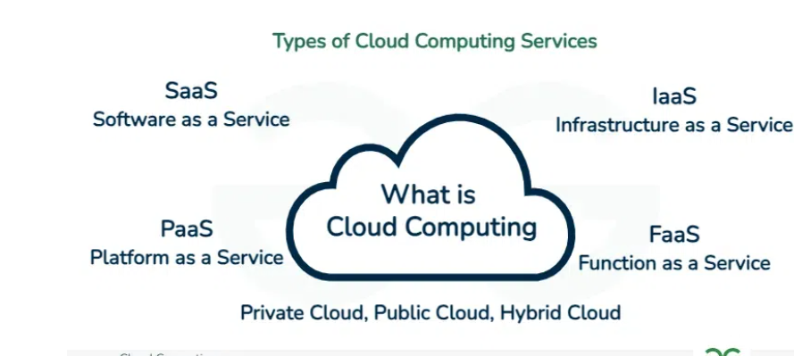

Slide 79
Platform as a Service | PaaS
Platform as a Service (PaaS) provides a runtime environment. It allows programmers to easily create, test, run, and deploy web applications. You can purchase these applications from a cloud service provider on a pay-as-per-use basis and access them using an Internet connection. In PaaS, back-end scalability is managed by the cloud service provider, so end-users do not need to worry about managing the infrastructure.

Slide 80
Examples of PAAS (Platform as a Service)
AWS Lambda
Google App Engine
Google Cloud
IBM Cloud

Slide 81
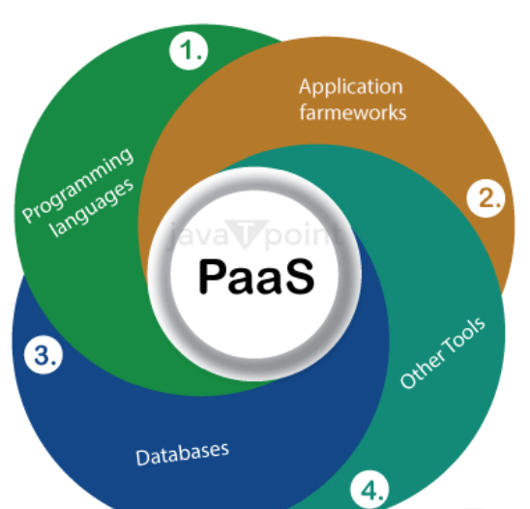

Slide 82
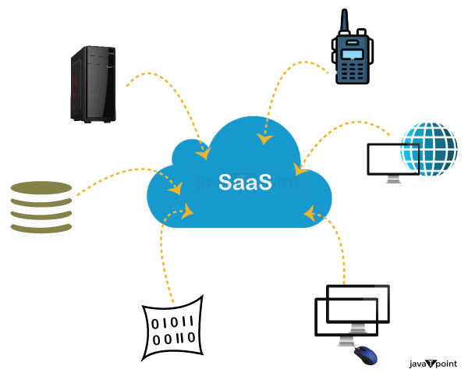

Slide 83
Software as a Service | SaaS
SaaS is also known as "On-Demand Software." It is a software distribution model in which services are hosted by a cloud service provider. These services are available to end-users over the internet, so the end-users do not need to install any software on their devices to access these services.

Slide 84
Web-based Delivery: SaaS apps can be accessed from anywhere with an internet connection because they are supplied over the internet, often through a web browser. Users no longer need to install and maintain software programs on their local machines as a result.
Multiple Users or "tenants" can access SaaS applications from a single instance of the program thanks to the concept of multi-tenancy. As a result, the provider can serve several clients with the same application without administering unique program instances for every client.
Automatic Updates: SaaS providers are in charge of keeping the software up to date and making sure that everyone has access to the newest features and security patches. Users are no longer required to manually install updates or fixes as a result.

Slide 85
Scalable: SaaS systems are scalable, which can readily grow or shrink in response to user demand. This frees up enterprises from worrying about infrastructure or licensing fees and lets them add or remove users as needed.
Pricing on a Subscription Basis: SaaS programs are frequently sold using a subscription-based pricing model, in which customers pay a monthly or yearly price to access the program. As a result, companies won't need to invest significantly in software licenses upfront.
Data Security, including data encryption, access restrictions, and backups, is the responsibility of SaaS providers. Users no longer need to handle their own data security because of this.

Slide 86
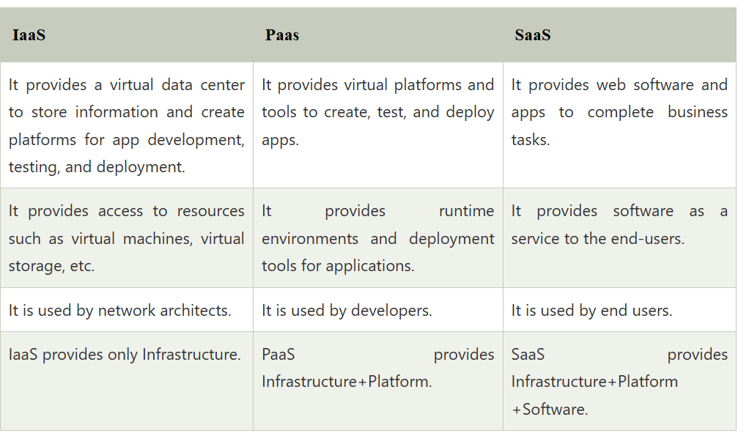

Slide 87
Example of SAAS (Software as a Service)
Salesforce
Google Workspace apps
Microsoft 365
Trello
Zoom
Slack
Adobe Creative Cloud

Slide 88
Function as a service (FaaS) is a cloud-computing service that allows customers to run code in response to events, without managing the complex infrastructure typically associated with building and launching microservices applications.

Slide 89
Some Popular Examples of FaaS Platforms Include
IBM Cloud Functions
Amazon's AWS Lambda
Google Cloud Functions
Microsoft Azure Functions (Open Source)
OpenFaaS (Open Source)

